Slide 1

Maximum & Minimum Applied Electronics Example 2
RCET 0264 Introductory Calculus
Tim Leishman

Slide 2
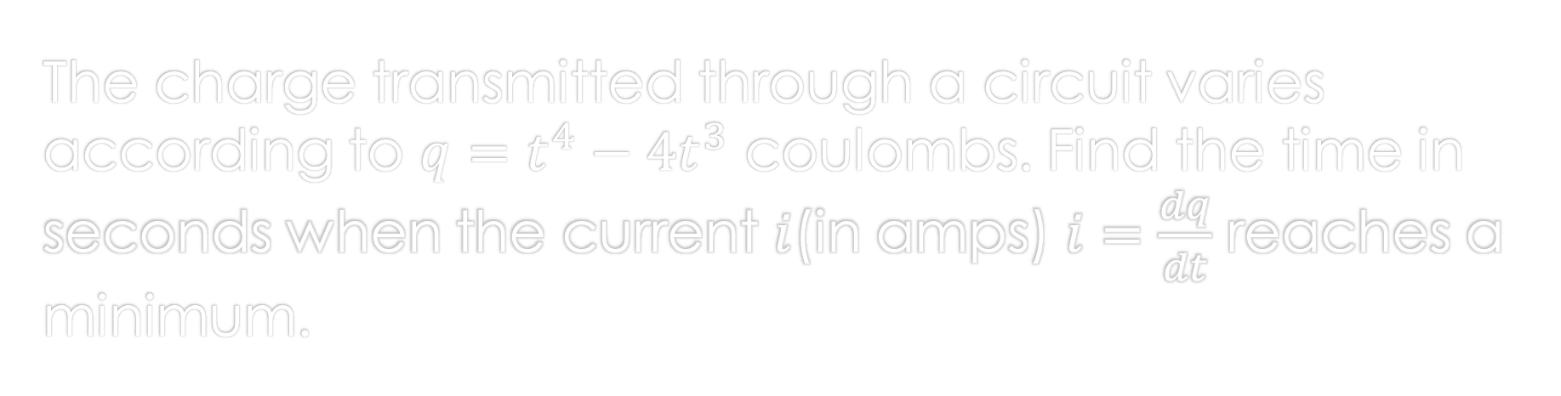
Maximum & Minimum
The charge transmitted through a circuit varies according to $q=t^{4}−4t^{3}$ coulombs. Find the time in seconds when the current $i$(in amps) $i=\frac{dq}{dt}$ reaches a minimum.

Slide 3

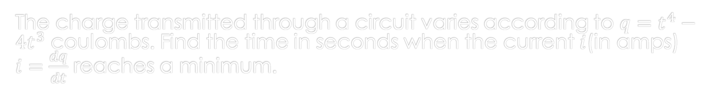
Maximum & Minimum
The charge transmitted through a circuit varies according to $q=t^{4}−4t^{3}$ coulombs. Find the time in seconds when the current $i$(in amps) $i=\frac{dq}{dt}$ reaches a minimum.
$q=t^{4}−4t^{3}$
$$i=\frac{dq}{dt}$$
$\frac{dq}{dt}= {4t}^{3}$-${12t}^{2}$
$i={4t}^{3}\text{-}{12t}^{2}$

Slide 4

Maximum & Minimum
The charge transmitted through a circuit varies according to $q=t^{4}−4t^{3}$ coulombs. Find the time in seconds when the current $i$(in amps) $i=\frac{dq}{dt}$ reaches a minimum.
Find the time in seconds when the current $i$(in amps)is at min
$i={4t}^{3}\text{-}{12t}^{2}$
$\frac{di}{dt}=12t^{2}−24t$
$0=12t^{2}−24t$
$12t^{2}−24t+0=0$
$x=0 or 2$
$x=2sec$

Slide 5
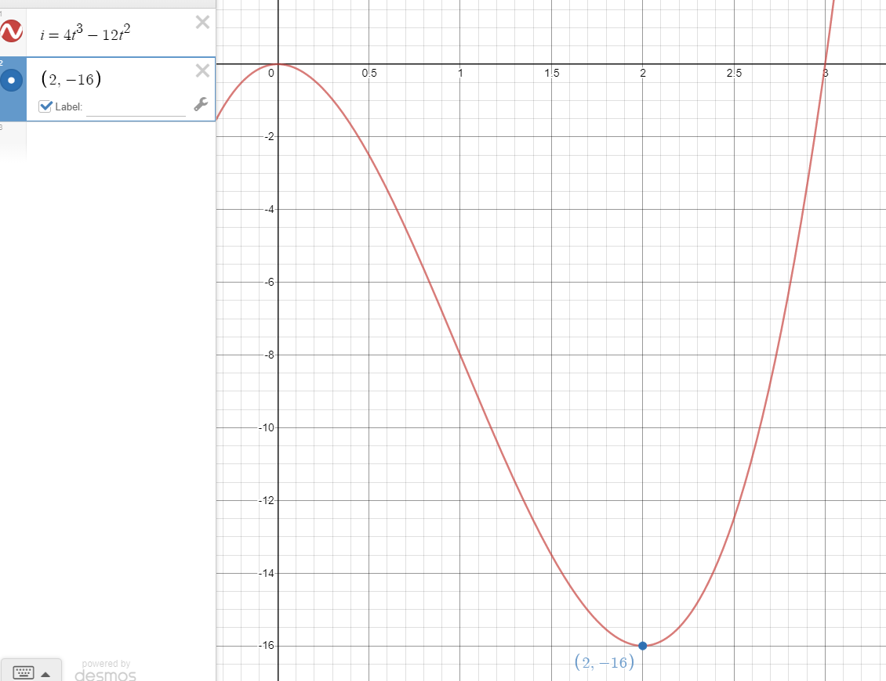

Maximum & Minimum
The charge transmitted through a circuit varies according to $q=t^{4}−4t^{3}$ coulombs. Find the time in seconds when the current $i$(in amps) $i=\frac{dq}{dt}$ reaches a minimum.
$x=2sec$
$i={4t}^{3}\text{-}{12t}^{2}$
$i={4(2)}^{3}\text{−}{12(2)}^{2}$
$i=32−48$
$i=−16 amps$

Slide 6
Maximum & Minimum
References:
Ewen, D., Gary, J. S., & Trefzger, J. E. (2005). Technical calculus. Upper Saddle River, NJ: Pearson/Prentice Hall.
https://www.desmos.com
https://www.autodesk.com/products/fusion-360/overview

